Slide 1
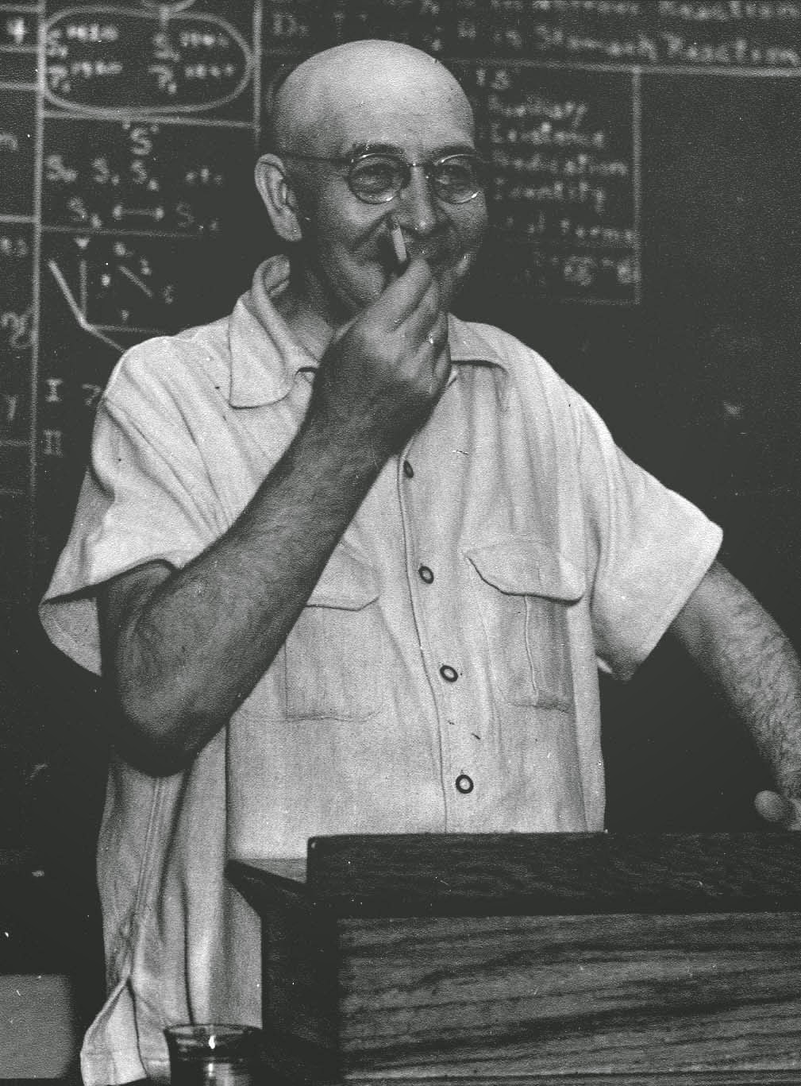
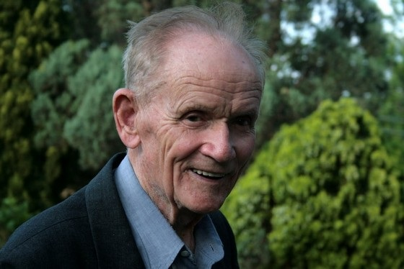
Australian General Semantics Society
13th September 2020 11 am
Welcome to our Springtime Seminar: "Unconscious Bias / Implicit Association"
How much of our 'mapping of the territory' about ourselves and our world is based on accurate observation, and how much of it is derived from factors that we either consciously deny or are truly unaware of? The unwilling-unable distinction is like the difference between purposely hiding something from others and unconsciously hiding something from oneself.
Presented by Robert James.

Slide 2
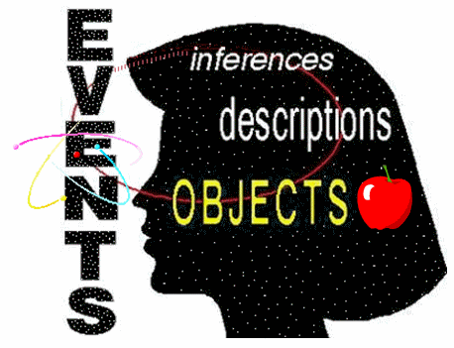
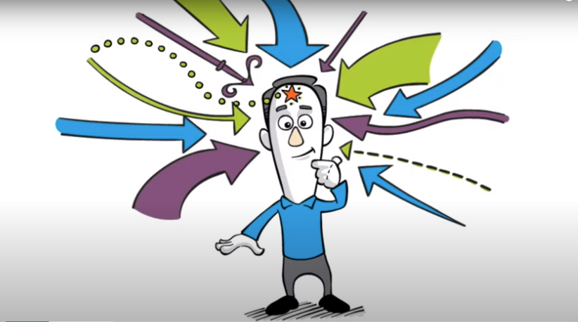
Our “two brains – Conscious and Unconscious”

Slide 3
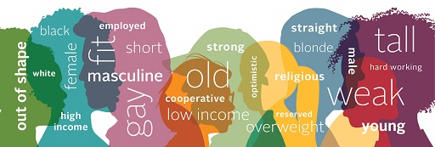
We’ve worked on this theme before …
Fourteen years ago, in March 2006, David referred to this in working on some of the formulations: http://members.pcug.org.au/~ajames/agsEvents2006March.htm
1) Identification a) Vertical identification of different abstraction levels, eg: Reification (identifying abstract concepts/formulations with concrete objects that do not exist) and Fact-Inference confusion. b) Horizontal identification. Where one treats A1 as identical to A2 - racism, sexism, ageism, etc.
2) Projection (seeing properties as projected out there, that you have made up in your nervous system.) i.e. projection ignores the observer-observed process.
3) Either/Or thinking. It is easier to think in black and white polarised terms than in shades of grey. And how the Availability Bias helps make this happen.
Eight years ago, in August 2012, we had our Professor Gabriel Donleavy’s presentation:
http://members.pcug.org.au/~ajames/agsEvents2012August.htm
Notes:
http://members.pcug.org.au/~ajames/agsEvents2006March.htm

Slide 4
Implicit Association (“Unconscious Bias”)
How much of our 'mapping of the territory' about ourselves and our world is based on accurate observation, and how much of it is derived from factors that we either consciously deny or are truly unaware of? The unwilling-unable distinction is like the difference between purposely hiding something from others and unconsciously hiding something from oneself.

Slide 5
Types of Bias
1 Anchoring Bias (1st information disproportionately influence later judgements. Related to contrast effect)
2 Availability Bias (Focusing on what you know / what is shown. Lack of perspective)
3 Bandwagon Effect (Aka group thinking. Doing like the others, social pressure)
4 Choice Supportive Bias (A choice unknowingly becomes cue of superiority, eg religion, partisanism)
5 Confirmation Bias (Searching for proofs of current point of view. Misinterpret contradictory evidences.
6 Ostrich Bias (Ignore or rationalize negative information)
7 Outcome Bias (Base the effectiveness of a decision on its outcome, neglecting other factors.
8 Overconfidence (Stop making decision based on facts after a series of successes)
9 Placebo Effect (The belief of an outcome improves its likeness. I'm not sure why it's classified as a bias)
10 Survivorship Bias (Only taking into account the positive outcomes, which gives irrelevant correlations)
11 Selective Perception (Ostrich + Confirmation combined?)
12 Blindspot Bias (Thinking that we are less biased than the next folk).

Slide 6
The Implicit Association Test (IAT)
A controversial assessment in the field of social psychology intended to detect the strength of subconscious association between mental representations memory.
Commonly applied to assess implicit stereotypes, eg biases in racial groups, gender, sexuality, age, and religion, as well as assessing self-esteem.
It is not designed to assess “what we think” about the associations, It does not ask “what we like”.
>800,000 subjects.

Slide 7
The Implicit Association Test (IAT)
Limitations / Controversary
Assesses familiarity or cultural knowledge irrespective of personal endorsement of that knowledge.
Lack of empirical research justifying the diagnostic statements that are given to the lay public.
For instance, feedback may report that someone has a [slight/moderate/strong] automatic preference for [European Americans/African Americans].
Lack of consistency if someone does the same test a number of times.
Proponents of the IAT have responded to these charges, but the debate continues, as with other psychological assessments, eg:
For “personality” (eg Myers Briggs), or
For “intelligence”, etc …

Slide 8
The Implicit Association Test (IAT)
The Implicit Association Test (IAT) makes it possible to penetrate both of these types of hiding.
The IAT measures implicit attitudes and beliefs that we are either unwilling or unable to report.
Are you willing to unlock this door to your unconscious and have a peep inside ... ?
So … How did we go with our homework …

Slide 10
IAT Outcomes!
From Person-1:
I have done a few of the implicit implication tests
and they are rather enlightening and fun to do !

Slide 11
IAT Outcomes!
From Person-2:
I couldn't do the homework. G.S. principles keep popping up.
For instance: In the "fat-thin" exercise, I couldn't ignore the fact that (even in the context of a test) I don't relate to individuals in terms of fat-thin, black-white, and so on.
Over the years, I have had friends on both sides.
I remember a similar problem with answering some questions in the “Myers Briggs” and other tests.

Slide 12
IAT Outcomes!
From Person-3: Your data suggest a moderate association of Male with Science and Female with Humanities.

Slide 13
IAT Outcomes!
From Person-4: Your data suggest a moderate association of Male with Science and Female with Humanities.

Slide 14
IAT Outcomes!
From Person-5: Your data suggest …
a strong preference for “thin” people compared to “fat” people,
a slight preference for “straight” people compared to “gay”,
a slight preference for “white” people compared to “coloured”.

Slide 15
Cognitive Bias https://www.verywellmind.com/what-is-a-cognitive-bias-2794963#causes
If you had to think about every possible option when making a decision, it would take a lot of time to make even the simplest choice. Because of the complexity of the world and the amount of information in the environment, it is necessary sometimes to rely on some mental shortcuts that allow us to act quickly. Cognitive biases can be caused by a number of things, but it is these mental shortcuts, known as heuristics, that play a major contributing role.
While they can often be surprisingly accurate, they can also lead to errors in thinking. Other factors that can also contribute to these biases:
Emotions,
Limits on our ability to process information
Social pressures
Ageing can cause decreased cognitive flexibility.

Slide 16
A Structural Differential view …
<= “The reality”

Slide 17
A Structural Differential view …
<= “The reality”
<= Limits on our perception

Slide 18
A Structural Differential view …
<= “The reality”
<= Limits on our perception
<= Personality (Optimistic, careful etc)

Slide 19
A Structural Differential view …
<= “The reality”
<= Limits on our perception
<= Personality (Optimistic, careful etc)
<= Emotions

Slide 20
A Structural Differential view …
<= “The reality”
<= Limits on our perception
<= Personality (Optimistic, careful etc)
<= Emotions
<= Experiences

Slide 21
A Structural Differential view …
<= “The reality”
<= Limits on our perception
<= Personality (Optimistic, careful etc)
<= Emotions
<= Experiences
<= Social pressures

Slide 22
A Structural Differential view …
<= “The reality”
<= Limits on our perception
<= Personality (Optimistic, careful etc)
<= Emotions
<= Experiences
<= Social pressures
<= Ageing – diminished cognitive flexibility

Slide 23
A Structural Differential view …
<= “The reality”
<= Limits on our perception
<= Personality (Optimistic, careful etc)
<= Emotions
<= Experiences
<= Social pressures
<= Ageing – diminished cognitive flexibility
History

Slide 24
A Structural Differential view …
<= “The reality”
<= Limits on our perception
<= Personality (Optimistic, careful etc)
<= Emotions
<= Experiences
<= Social pressures
<= Ageing – diminished cognitive flexibility
History
Culture

Slide 25
A Structural Differential view …
<= “The reality”
<= Limits on our perception
<= Personality (Optimistic, careful etc)
<= Emotions
<= Experiences
<= Social pressures
<= Ageing – diminished cognitive flexibility
History
Culture
Expectations

Slide 26
A Structural Differential view …
<= “The reality”
<= Limits on our perception
<= Personality (Optimistic, careful etc)
<= Emotions
<= Experiences
<= Social pressures
<= Ageing – diminished cognitive flexibility
<= History
<= Culture
<= Expectations
<= Assumptions

Slide 27
Our Computer Future …
As we general semanticists are surely aware, “all” symbol systems have biases!
They involve abstractions which require making choices.
Postman (1993) argues that the computer is biased toward seeing the world in terms of numbers, and this bias leads to the claim that all our problems can be solved by fast calculations. (Needless to say, he disagrees with this claim.)
These days, we’re often not thinking about “a computer”, but by complex systems involving many disbursed computers, multiple ever-changing data bases, and complex algorithms.
So … can computer systems make complex decisions, devoid of silly human biases … ?

Slide 28
“Nah – Computer algorithms would never be biased!”
Computers do as programmed, but this is not necessarily simple, especially with AI, eg: Biometric recognition (facial, voice, iris, etc), Public administration (eg “Robo debt”), Romantic match-making (like RSVP), Decisions like “Should we go to war?” Autonomous weapons systems, Natural speech recognition, Criminal case-vetting, Weather forecasting, Economic modelling, Pandemic modelling, Satellite navigation, Robotic surgery, Data mining, Etc … etc.

Slide 29
“Nah – Computer algorithms would never be biased!”
Computers do as programmed, but this is not necessarily simple, especially with AI, eg: Biometric recognition (facial, voice, iris, etc), Public administration (eg “Robo debt”), Romantic match-making (like RSVP), Decisions like “Should we go to war?” Autonomous weapons systems, Natural speech recognition, Criminal case-vetting, Weather forecasting, Economic modelling, Pandemic modelling, Satellite navigation, Robotic surgery, Data mining, Etc … etc. | GIGO - garbage in – garbage out – fundamental to data processing. Complex data models have bias built into them, by the analysts, designers, and programmers who create them, and by choice of the data they are given to process. Bias is introduced by such factors as * Inaccurate “mapping of territory”, * Incomplete or non-representative data, * Selective reporting. Bias exists in to the limitations of the human beings who create the programs, select the data and interpret the results. Algorithms may be biased in adversarial terms, because of "the logic of the excluded middle”.

Slide 30
A Case study - Microaggressions
Microaggressions can be subtle, well-intentioned, indirect, eg:
“Where are you from?”,
“You don't look Jewish / gay / autistic … ”,
“You're the smartest black girl in the class!”
Can we think of other examples … ?
Notes:
18:03

Slide 31
Australian General Semantics Society
Thank you …
Go thy way,
and rationalize-away those pesky biases …

Slide 32
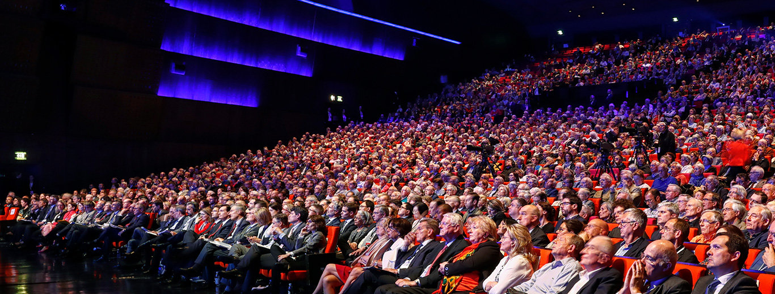
Australian General Semantics Society Inc Very Interesting Annual General Meeting!
Agenda
M’me Secretary’s Report (Minutes 2019)
President’s Report

